Slide 1
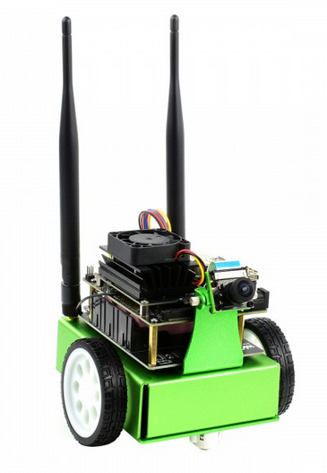
Lane detection using NVIDIA JetBot
FINAL PRESENTATION
ECE 536 - Digital Control System Projects
Sahil Deshpande, Shruti Shah, Hrishikesh Dey, Shobhit Sheel
Department of Electrical and Computer Engineering
North Carolina State University
Raleigh, NC

Slide 2
Agenda
Introduction
Materials and Hardware
Data Collection
System Identification
Controller Design
Results and Conclusions
Future Work

Slide 3
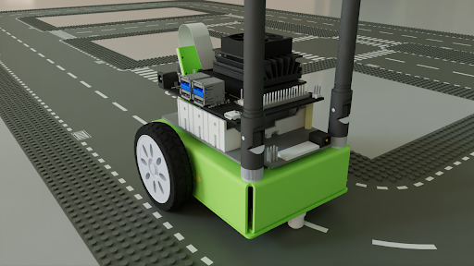
Introduction
Goal - Develop a vision-based self-driving car system using NVIDIA JetBot to identify lane lines and regulate the vehicle's speed and direction to navigate from source to destination.
Detect lanes using a camera with the NVIDIA jetbot and making sure the bot follows the lane.
https://developer.nvidia.com/blog/training-your-jetbot-in-isaac-sim/
Work Done -
Increased the dataset to ~700 images to train the model on the circular track.
Optimized the best path generated to avoid undesired latency from live camera feed.
Performed system identification to find G(z).
Used MATLAB PID-tuner to find the optimal tuning gains for our controller D(z).
Compared the performance with Lead-Lag and pole placement compensators.

Slide 4
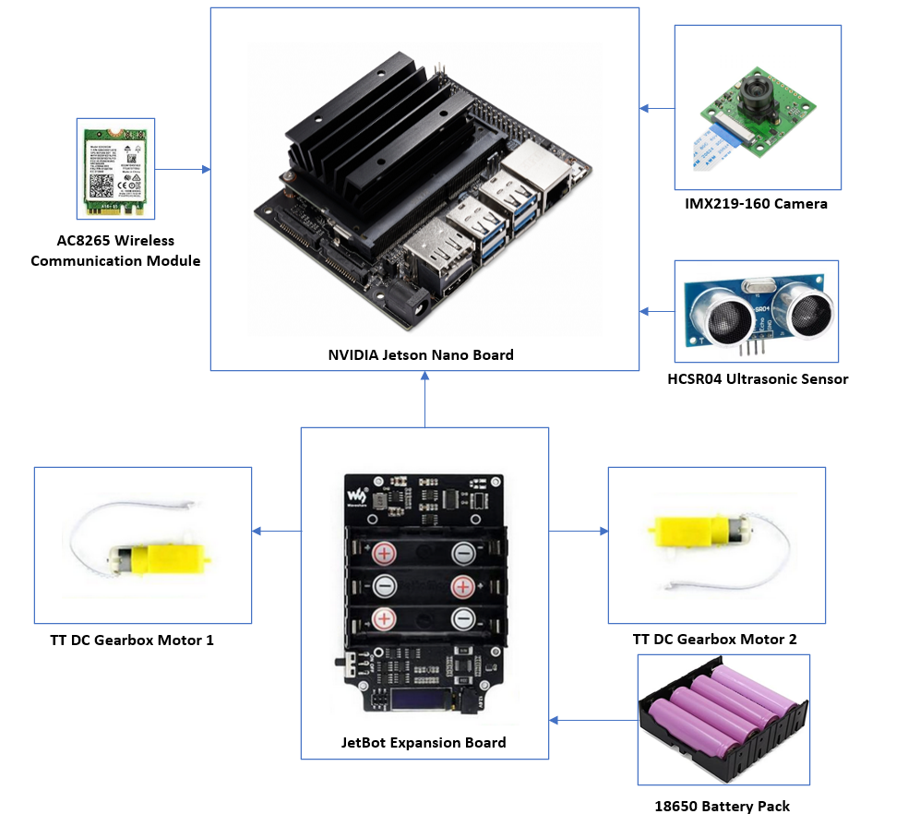
Materials and Hardware
All of the hardware components used in this project come from the Waveshare JetBot AI Kit.
Microcontroller: NVIDIA® Jetson Nano™ developer kit, Quad-core ARM A57 running at 1.43 GHz , 128-core Maxwell GPU.
Motors and Driver: TT DC Gearbox Motors, gear ratio 1:48 and TB6612FNG dual H-bridge motor driver
Wireless Communication Module: Intel® Dual Band Wireless-AC 8265 adapter, M.2: PCIe, Wi-Fi 5 (802.11ac) certified
Camera: Sony IMX219 8.08MP Color sensor, 160 degree FOV, CSI-2 MIPI 2-lane data output interface.
Battery Pack: LIR18650 Cylindrical Lithium Ion Rechargeable Cell with a Nominal Capacity of 2600mAh at 12.6 V.

Slide 5
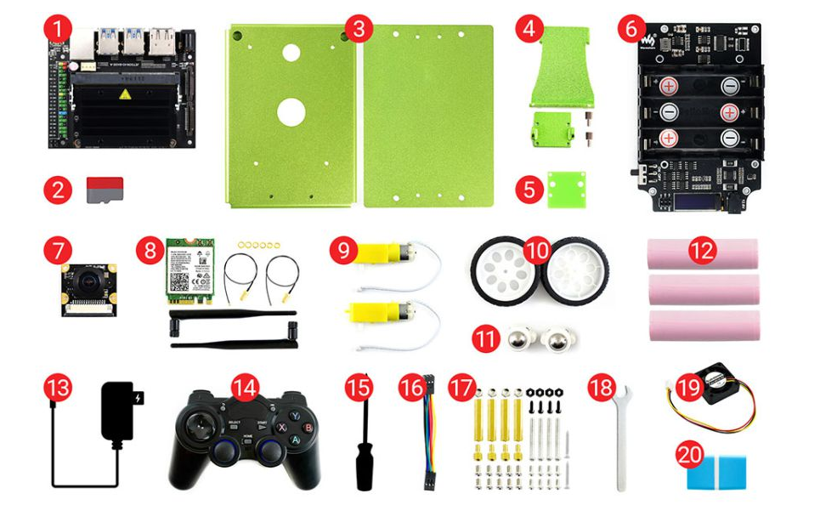
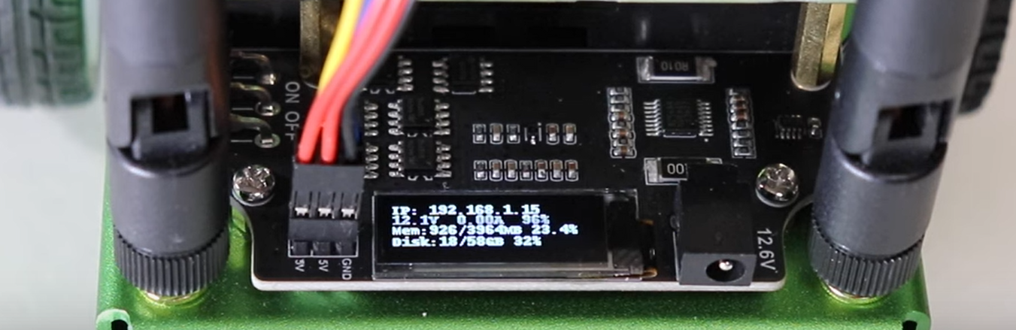
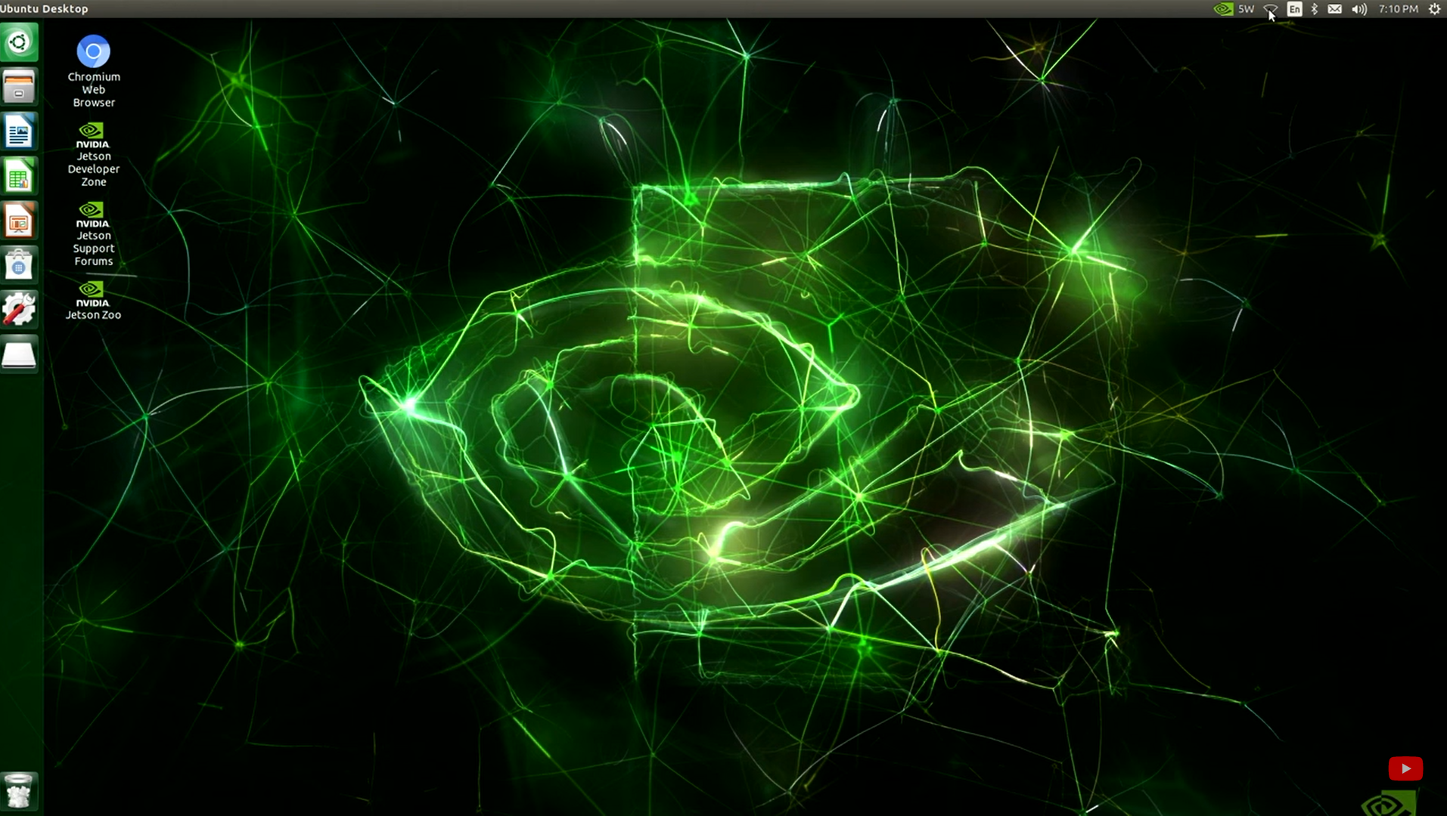
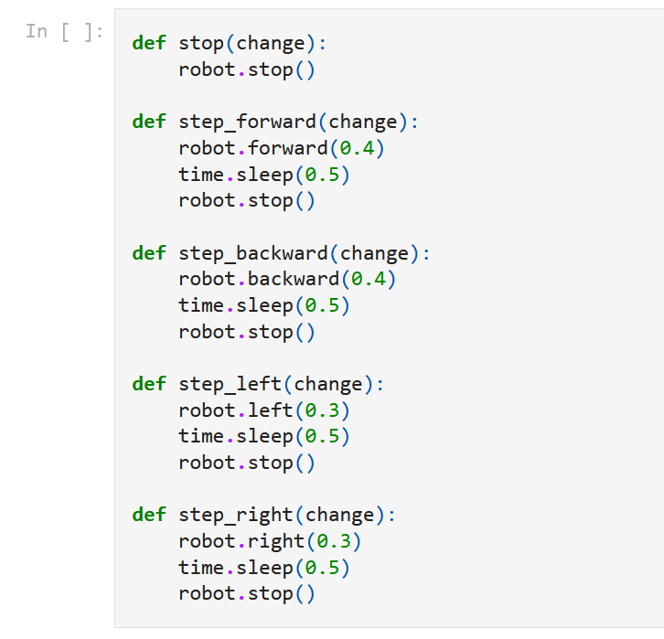
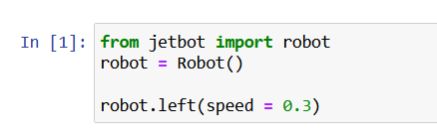
Materials and Hardware
Followed the Waveshare tutorial to assemble the JetBot.
JetPack SDK is a comprehensive resource for building AI applications. It includes Jetson Linux image together with accelerated software libraries, APIs, sample applications, developer tools, and documentation. Used Etcher to flash the JetBot Linux image on the SD card.
Connected the bot to WiFi logged into the bot using the
configured IP address.
Installed Python on the JetBot and tested the basic motion,
camera, and robot control using the Jupyter notebook.
Tested Basic Motion of the motors in the Jupyter Notebook - imported the JetBot library and initialized the robot class instance to control the bot using Python.
Hardware Assembly
Configured IP address can be seen on the OLED display
Ubuntu running on the JetBot
Basic Robot Motion Test using the JetBot Juypter Notebook

Slide 6
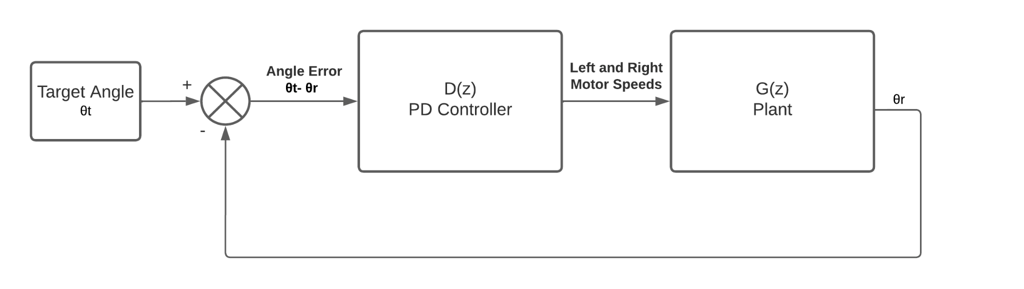
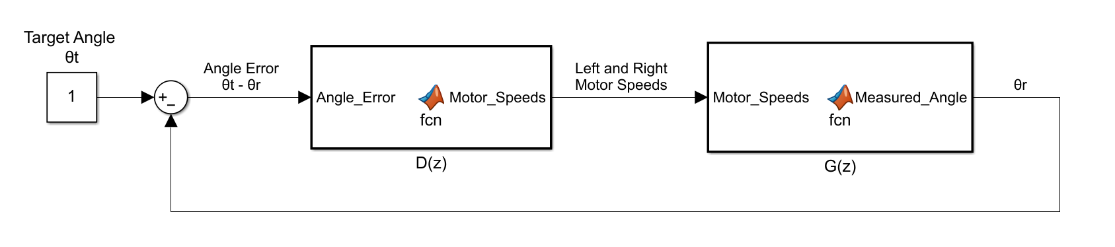
Control Objective
PD Controller tuned on optimal speed at which the bot is able to compensate of frame lagness and computational image processing stress for system identification.
PID/Lead/Lag/root-locus/pole placement controllers in cascade with the initial PD controller in the plant.

Slide 7
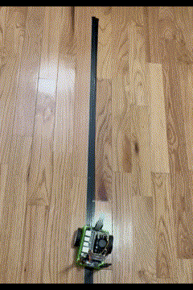
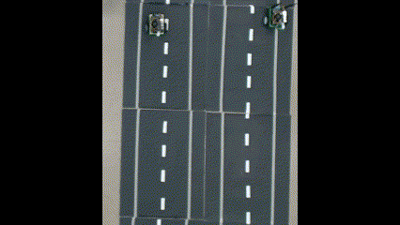
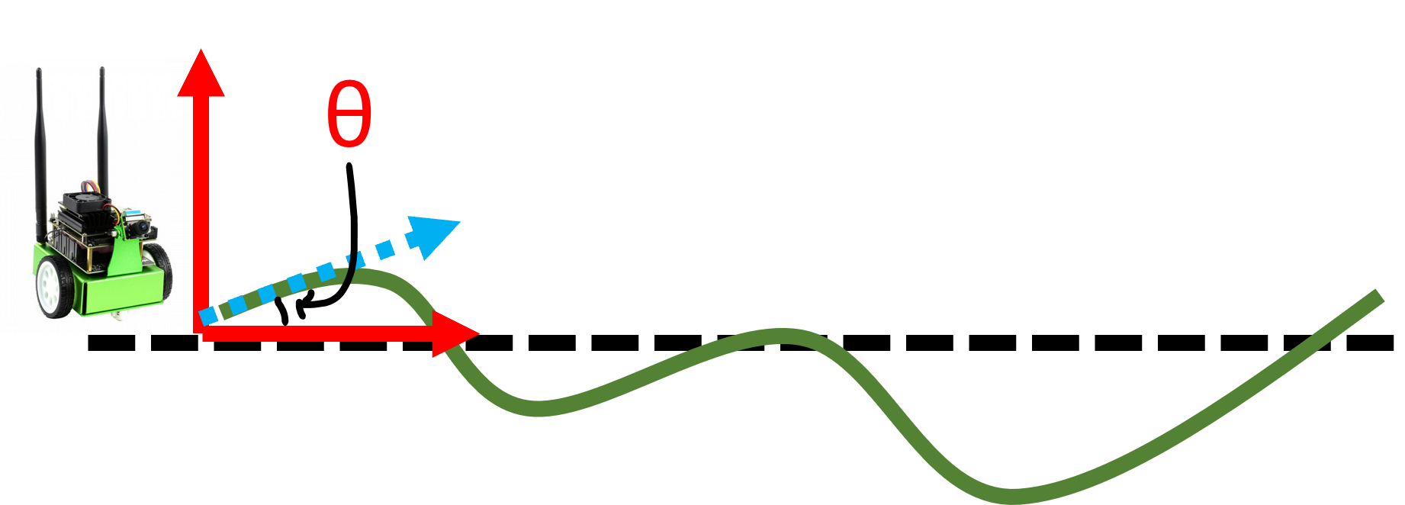
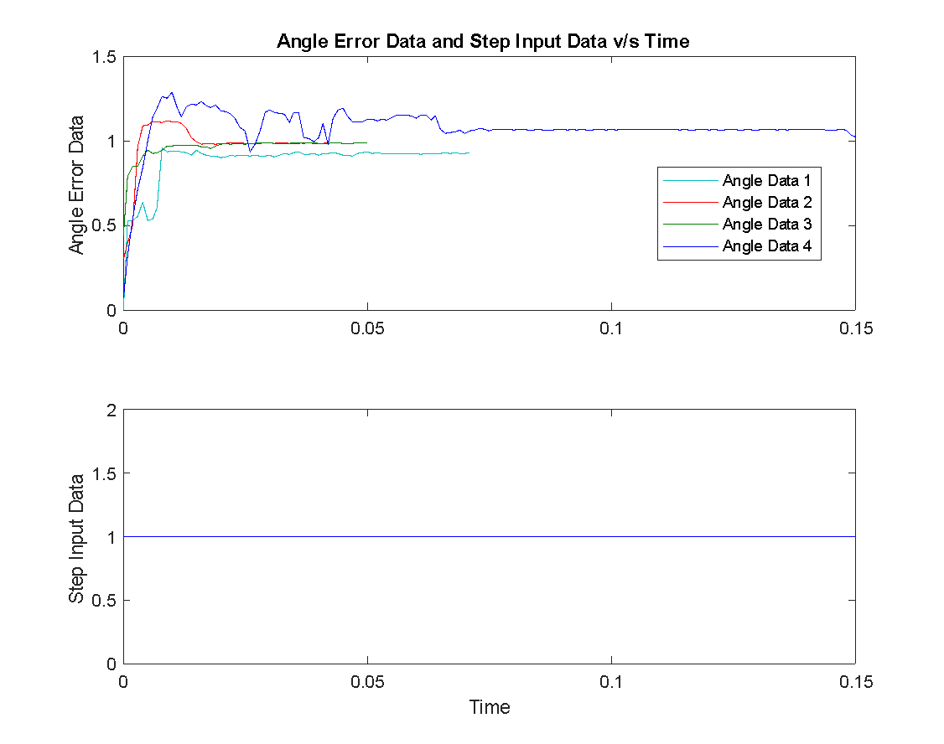
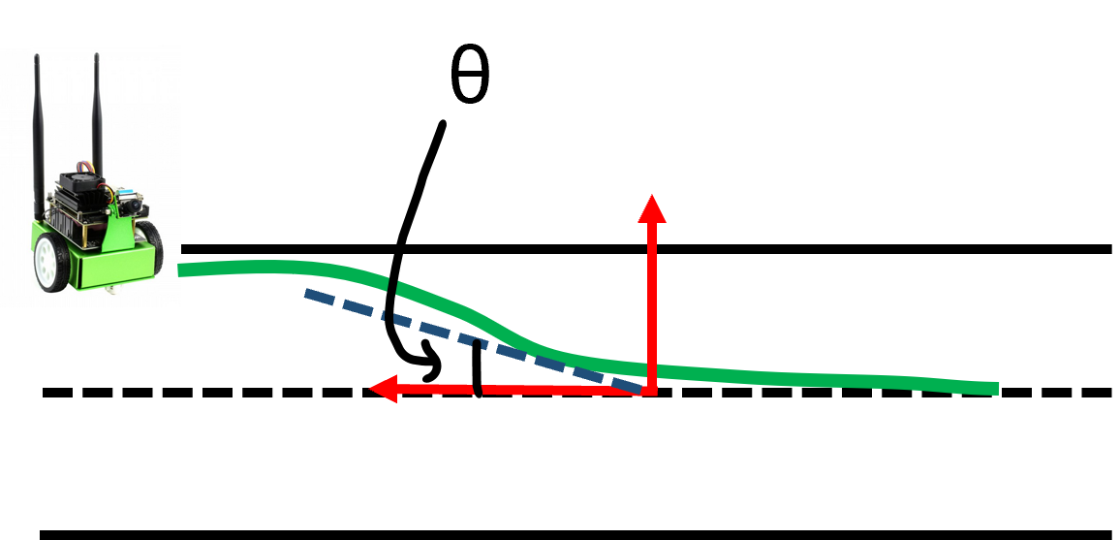
Data Collection
Previous Experimental Protocol
New Experimental Protocol

Slide 8
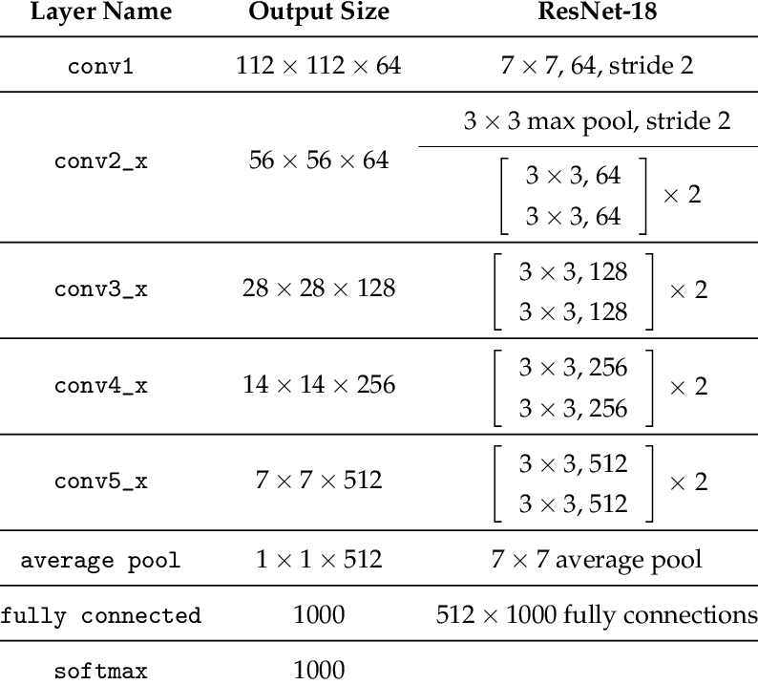
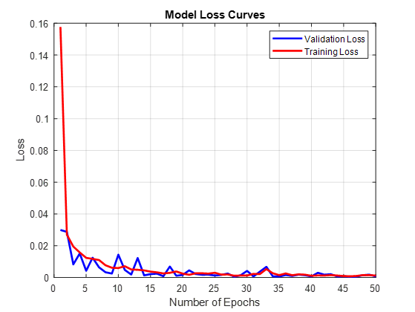
Computer Vision
Training the model
We have used PyTorch deep learning framework to train ResNet18 neural network architecture model for lane detection application. With the help of transfer learning we can repurpose a new trained model for a new task that has possibly much less data available.
The ResNet18 model has a fully connected final layer with 512 as input features and we have trained for regression the output features will be 1
Model Optimization
After training the model, we have optimized the model using TensorRT.
We used the torch2trt library and a pre-trained resnet18 model, on which the optimization needs to be performed for faster interference.We want our model to get optimized in FP16 precision which can be changed in the precision_mode parameters

Slide 9
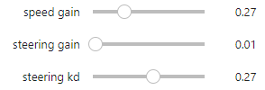
Computer Vision
Testing
We created a pre-processing function to normalize the trained loaded images, transfer the data from CPU to GPU memory and add a batch dimension
Following sliders are then defined to control the jetbot:
Speed Control (speed_gain_slider)
Steering Gain Control (steering_gain_slider)
Steering Bias (steering_bias_slider)
Played around with the sliders at a low speed to get the jetbot following the road track

Slide 10
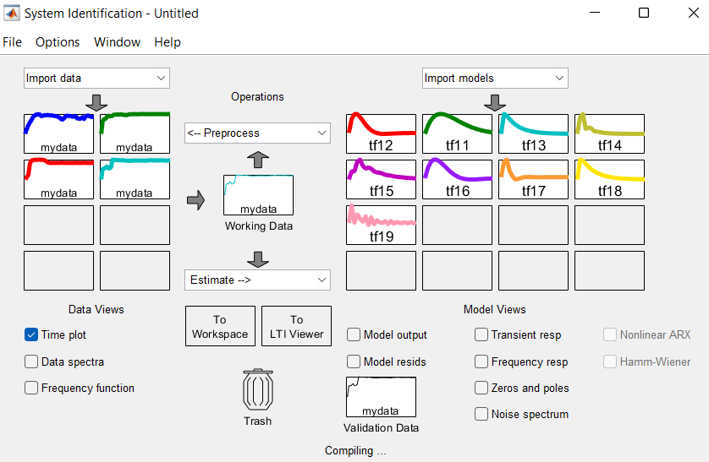
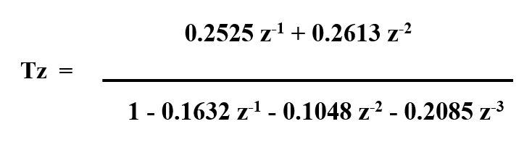
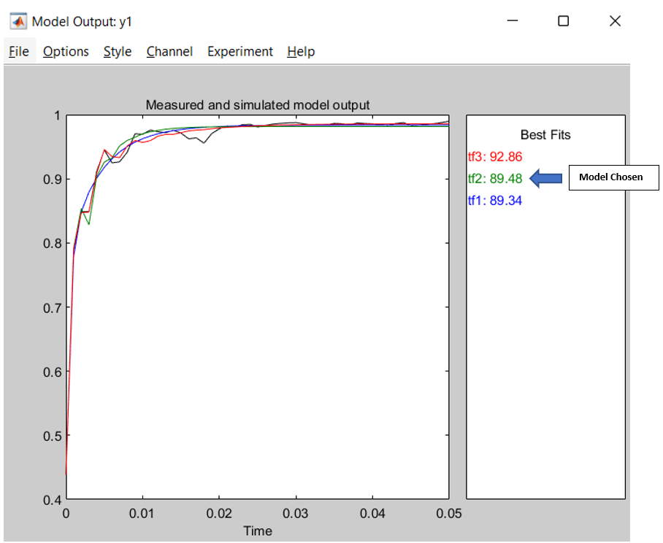
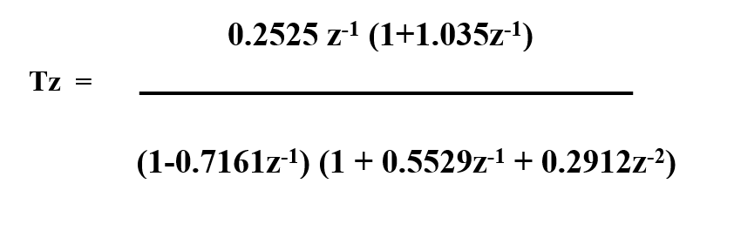
System Identification
Define input step for the system- move towards the centerline of the lane
selection of 3 poles 2 zeros system after system identification

Slide 11
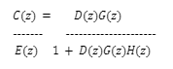
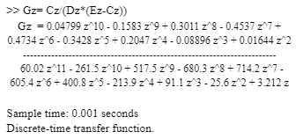
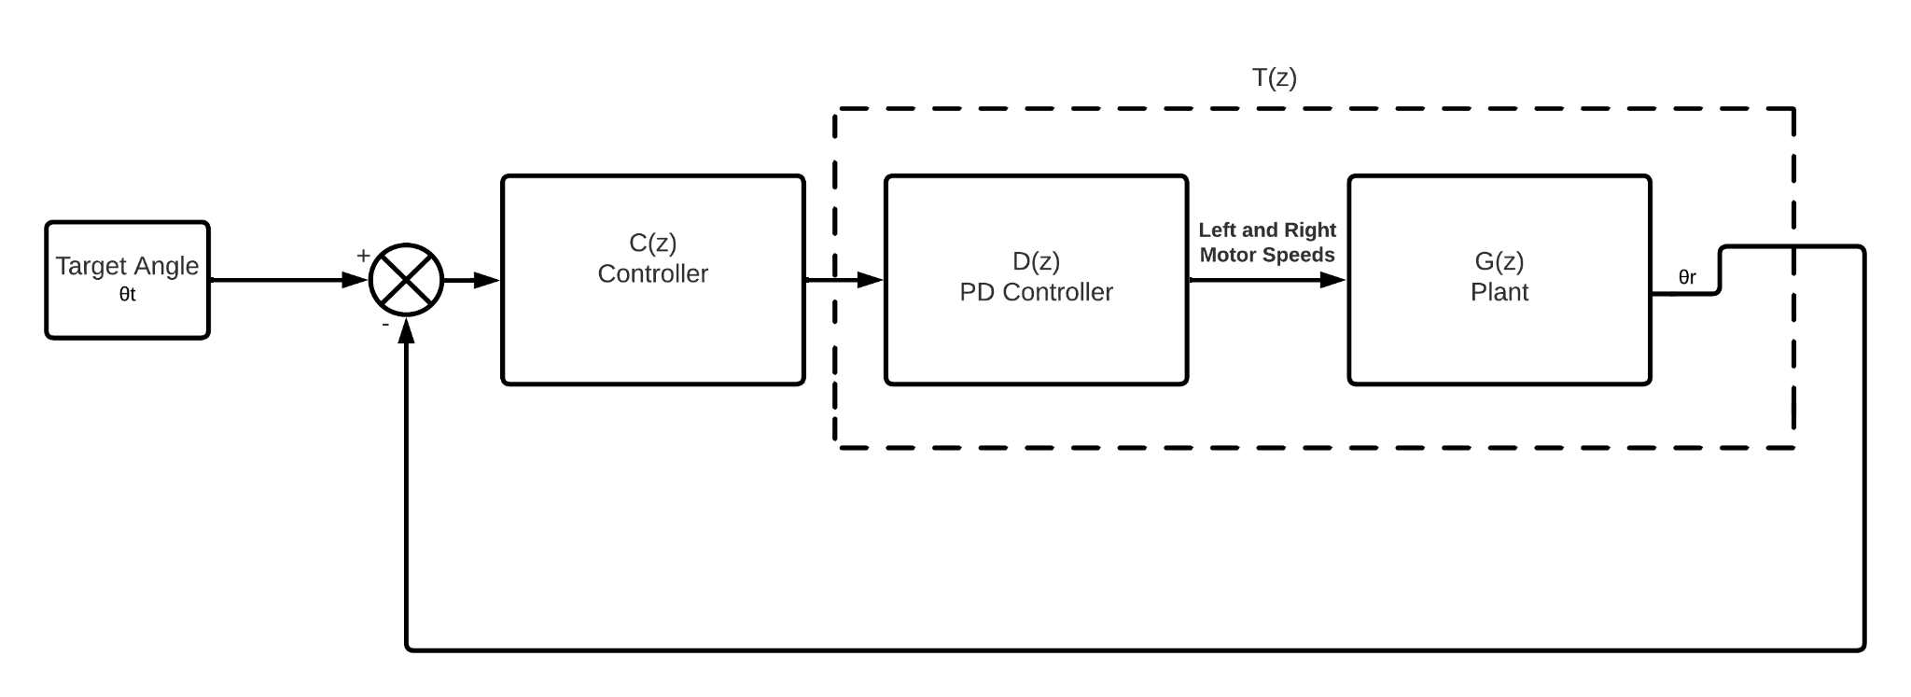
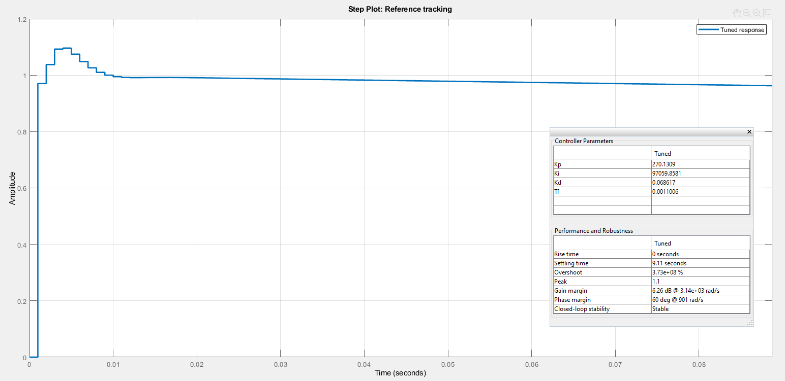
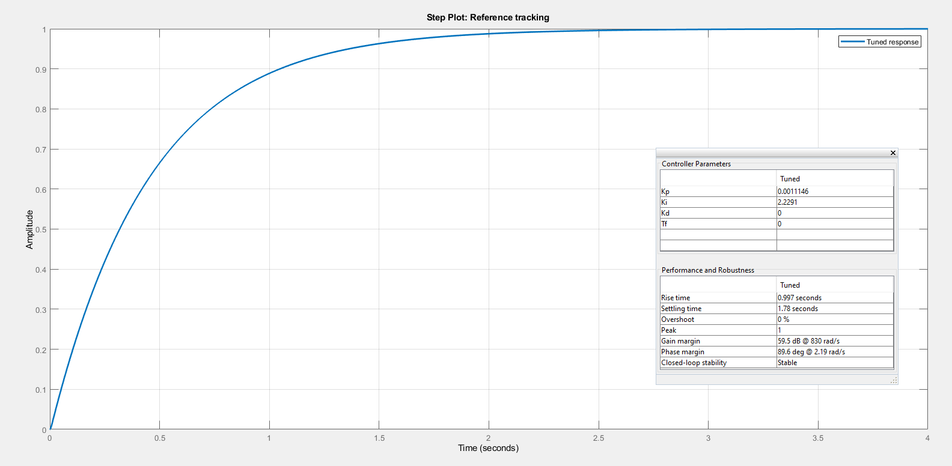
System Identification
Performed back calculation for plant G(z) identification
Changed approach to cascaded control
2 poles 1 zero open loop
plant= response + PD controller (3 poles 2 zero)

Slide 12
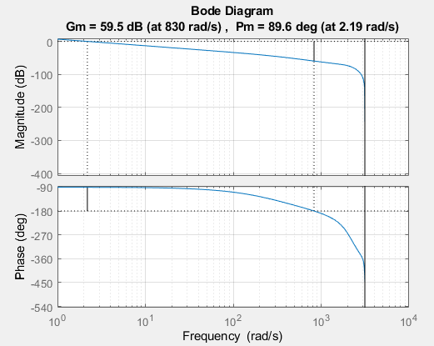
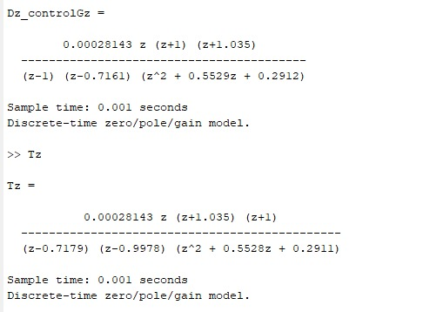
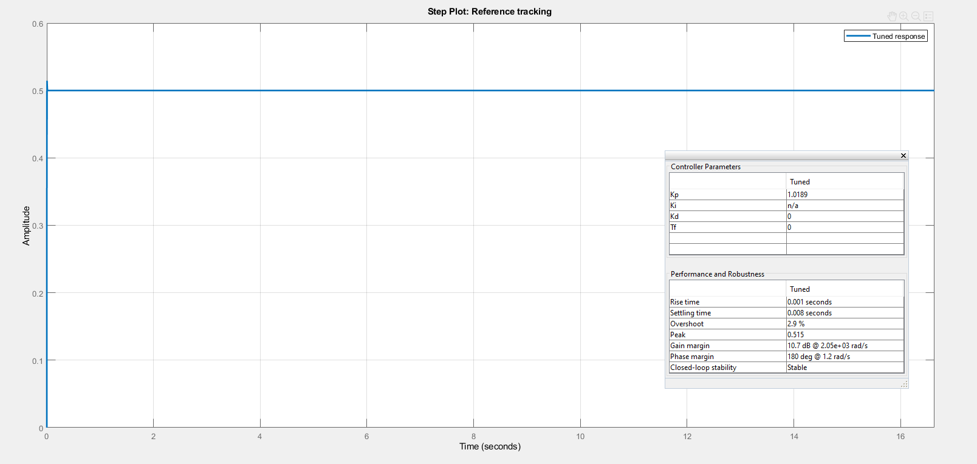
PID Controller
Used MATLAB pidTuner for tuning the selected plant of the system
Optimal performance with PIDF controller
Observed oscillation using normal PD control with lower gain values
PDF controller
PIDF controller

Slide 13
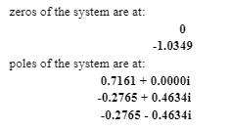
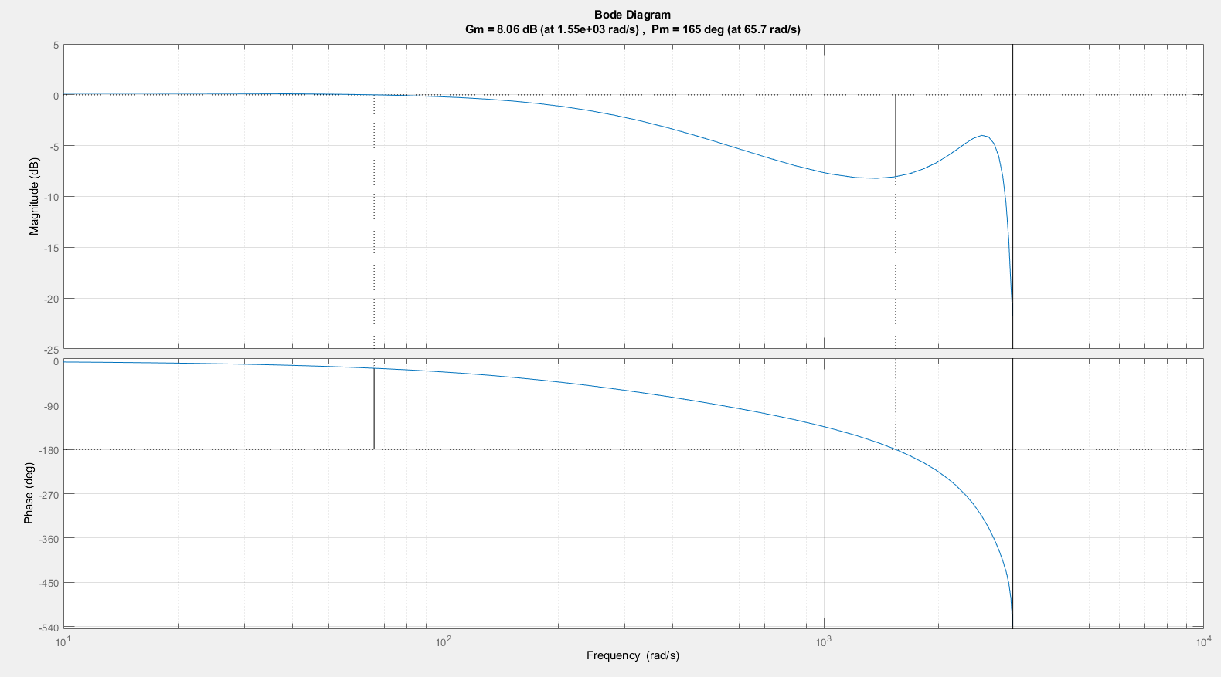
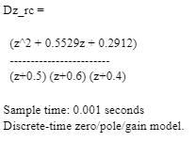
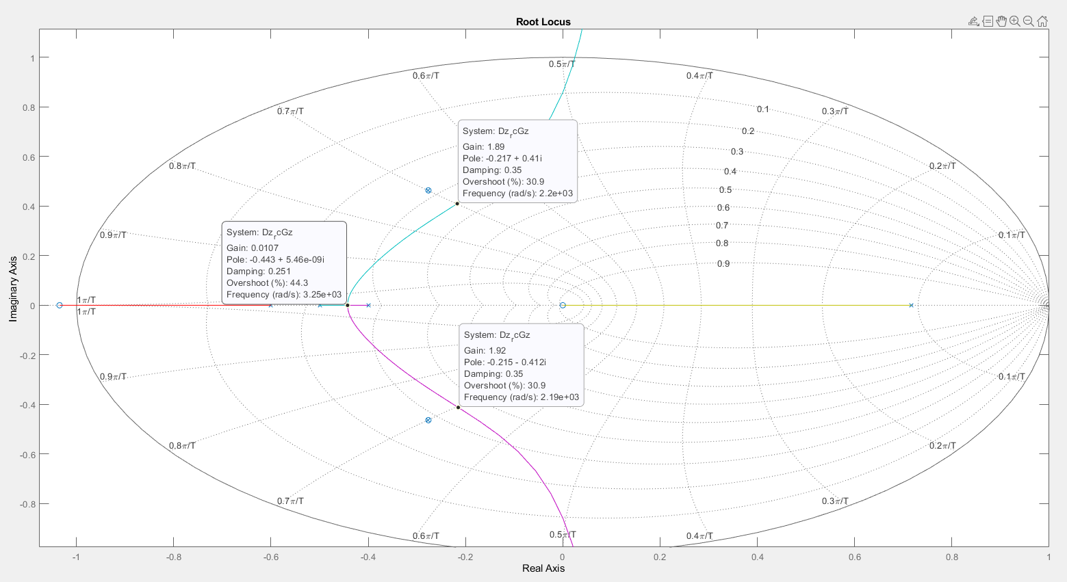
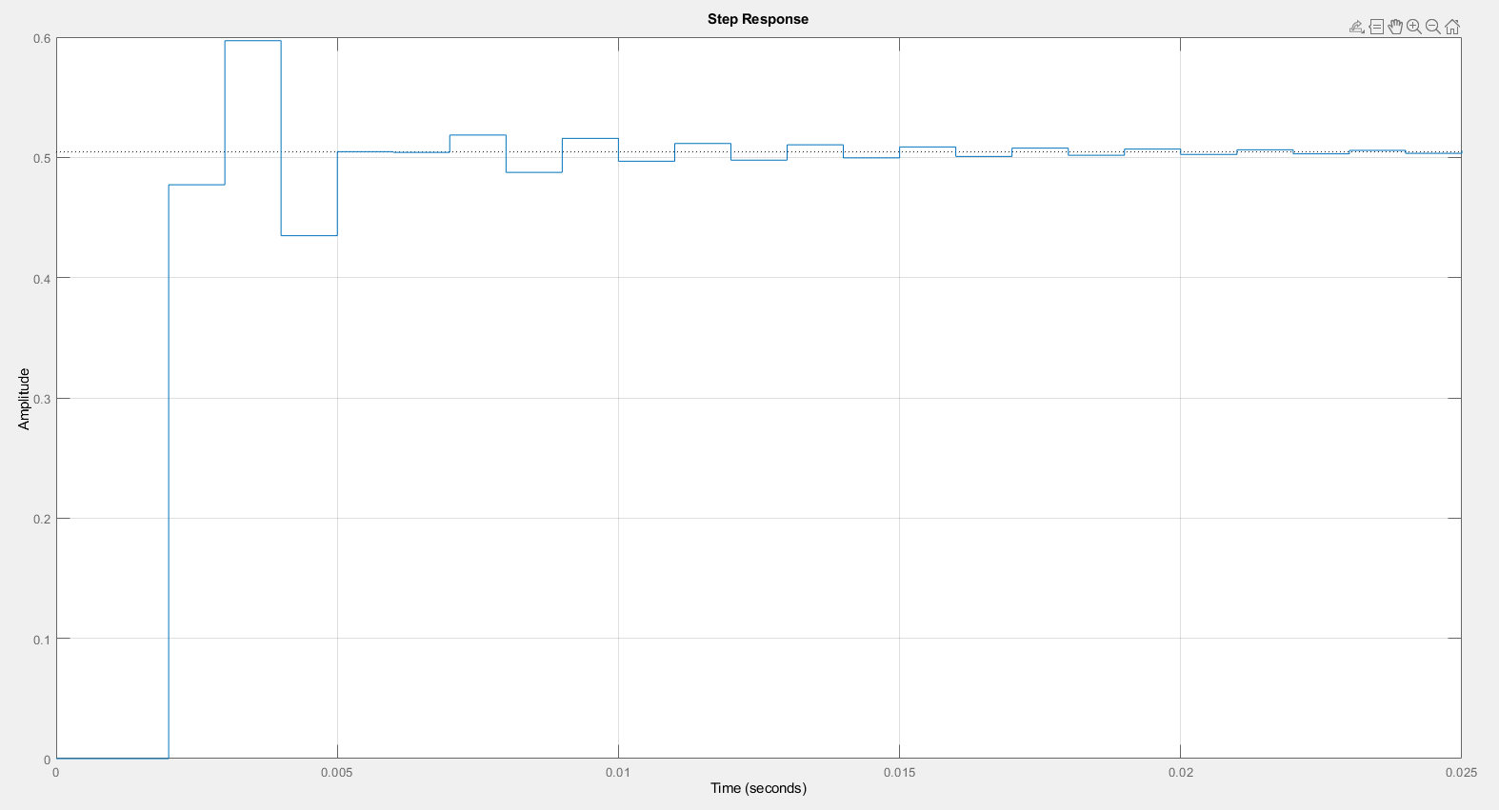
Pole Placement Controller
Addition of controller zeros to cancel comlex poles of the system
Controller poles taken at -0.5,0 and -1 initially
controller tuned to get optimal overshoot% with adjusting faster and slower response through changing pole from 0 and -1

Slide 14
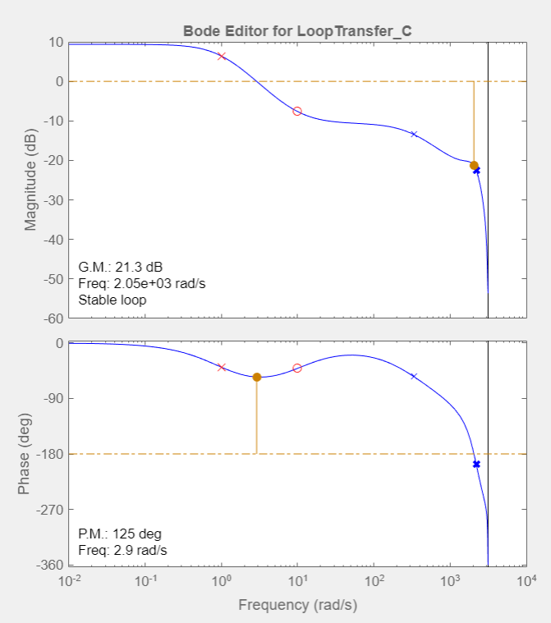
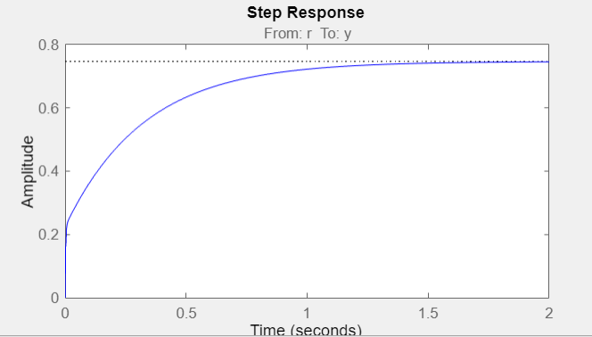
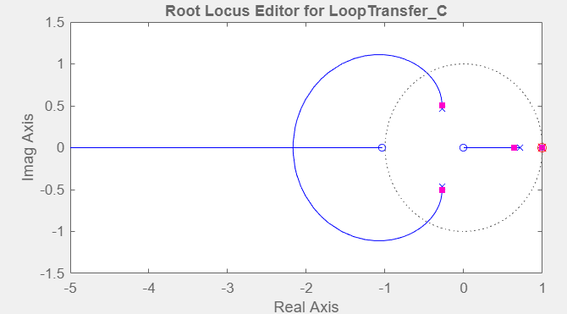
Lag Controller
Considering the 3 pole 2 zero model to design a Lag controller.
Designed a Lag controller using the MATLAB Sisotool with the default values: Dz = 0.30135 (z-0.99)
----------------------
(z-0.999)
From the step response below you can observe that with a small gain, the system is
not able to reach the steady state and with a big gain, the System becomes unstable
3 pole 2 zero model
Lag Controller Step Response

Slide 15
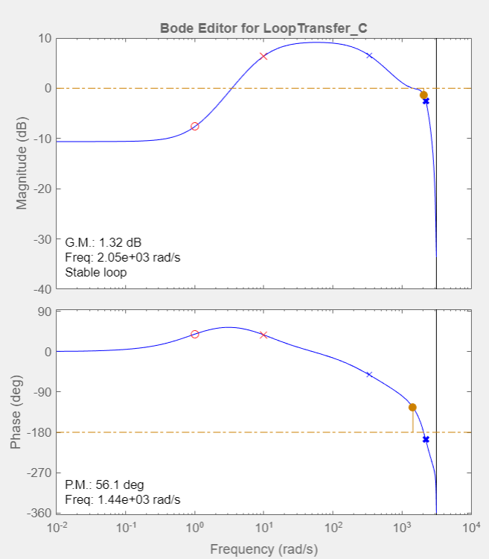
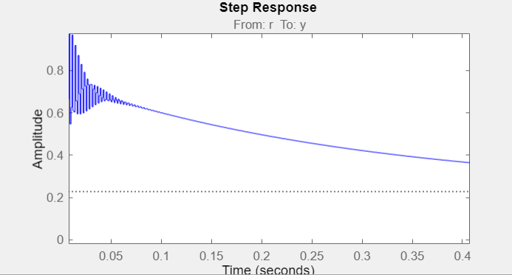
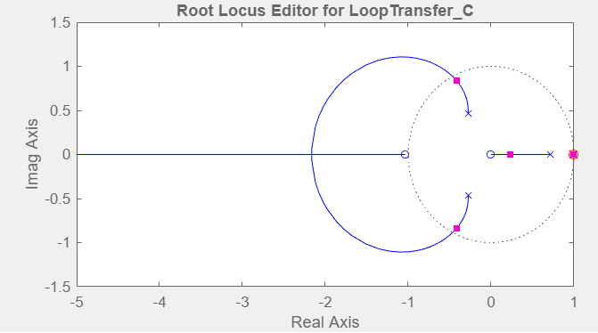
Lead Controller
Considering the 3 pole 2 zero model to design a Lag controller.
Designed a Lag controller using the MATLAB Sisotool with the default values: Dz = 2.9865 (z-0.999)
---------------------
(z-0.99)
From the step response below, you can observe that the system output goes
high for an initial spike and then destabilizes after a very short time.
3 pole 2 zero model
Lead Controller Step Response

Slide 16
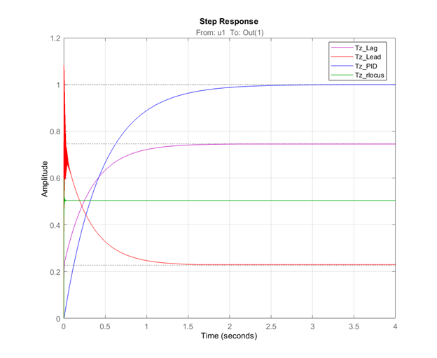
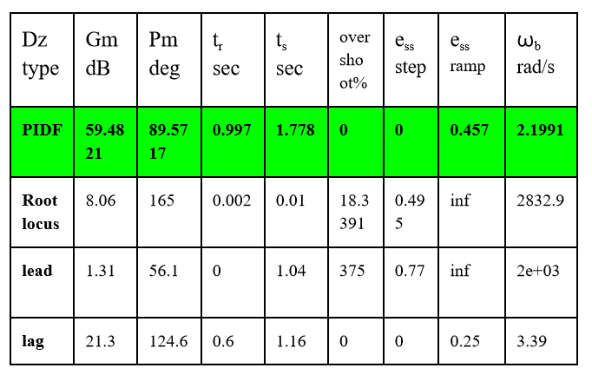
Results
From the table above and by comparing the step responses of all controllers, we can observe that the PID controller gives the best performance.

Slide 17
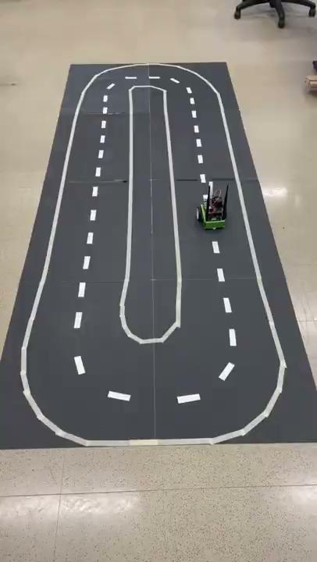

Working
Update-3 Tracking
Final Tracking

Slide 18
Challenges
Motor Deadband - Speed input of -0.3 to +0.3 gives zero speed of motors.
Initially the different lighting conditions and the small size of training images(100-150) affected the performance of the bot. We then designed a black oval track and more training images(700) which improved the performance of the bot.
Observed live camera feed latency: reduced action step size for compensation and reduced frame rate while gathering data points for training. Optimized the best path generated using TensorRT(minimizes memory footprint)to avoid undesired latency from live camera feed.
Realization of the system and establishing plant of the system- define a way to mathematically represent the system, changed the initial assumption to a cascaded control feedback system

Slide 19
Conclusion
We used a PID controller in cascade with the initial PD controller in our plant with defined Kp and Ki values.
Initially our bot was able to track the circuit well but at lower speed which caused some issues when encountering bumps or high torque requirements as the speed output was capped. After updating the controller we could track the designed circuit more smoothly and at higher speed as well as less frequent deviation from the center line.
Tighter tracking of the curved path was also observed. Overall the controller was compensating for the video lagness and we could also increase our step size amplitude and frame rate of the camera for faster computation.
Thus it can be concluded that after addition of the PID controller the performance of the jetbot improved.

Slide 20
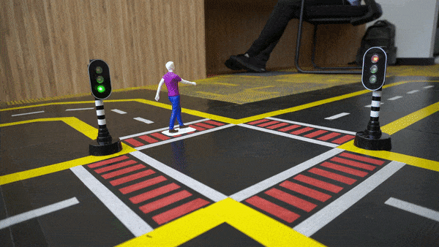
Future Work
Adding collision avoidance using the vision system where a classification model is trained for STOP and GO motion.
Lane changing process can be achieved by changing the path and adding ultrasonic sensors for left and right lane change.
Work towards improving frame rate and video computational effort would improve the overall performance of the system.
Addition of estimators like kalman filters can help improve performance as the system is based on the model predicting the required steering angle.
https://global.discourse-cdn.com/nvidia/original/3X/e/a/ea72298c8b2a3a036aa7449e1f3e6feefd49c1be.gif

Slide 21
References
AnbuKumar-maker. (n.d.). Anbukumar-maker/JetBot-custom-code: In this repository, I will be maintaining all the custom built python codes which are modified using the examples notebook of Nvidia JetBot package. there are lot of interesting modifications I have done, deployed on JetBot and rested the models. GitHub. Retrieved November 6, 2022, from https://github.com/AnbuKumar-maker/JetBot-Custom-Code
Altium, “NVIDIA Jetson Nano: Lane Detection and Tracking”, [online], [Accessed 2 October 2022].
Nvidia-Ai-Iot. (n.d.). Jetbot/notebooks/road_following at master · nvidia-ai-IOT/jetbot. GitHub. Retrieved November 6, 2022, from https://github.com/NVIDIA-AI-IOT/jetbot/tree/master/notebooks/road_following
Jetson ai fundamentals - S2E4 - jetbot road following. YouTube. (2020, November 2). Retrieved November 6, 2022, from https://youtu.be/VY7m4lPIOj0
MATLAB. (2013, May 3). Introduction to System Identification Toolbox. YouTube. https://www.youtube.com/watch?v=NrMRPrA6yKI
https://www.youtube.com/watch?v=13roclxHwAM&ab_channel=FaBo
ECE 536 Chapter 10b – System Identification-20220925 and class provide manuscript for Phillips, Nagle, and Chakrabortty, 4th Edition
Varty, J. (2019, April 16). Visualizing resnet18 activations. fast.ai Course Forums. Retrieved November 7, 2022, from https://forums.fast.ai/t/visualizing-resnet18-activations/43916

Slide 22
Thank You!

